Slide 1
Lecture 1 The Big Picture

Slide 2
Agenda

Slide 3
1. Infamous Software Error Case Studies
Disney's Lion King, 1994
Intel Pentium Floating-Point Division Bug, 1994
NASA Mars Polar Lander, 1999
Patriot Missile Defense System, 1991
The Y2K (Year 2000) Bug, circa 1974
(4195835/3145727)×3145727 - 4195835

Slide 4
2. What Is a Bug?
Terms for Software Failures
Software Bug: A Formal Definition
defect
fault
problem
error
incident
anomaly
variance
failure
inconsistency
feature
bug

Slide 5
Terms for Software Failures
Fault
Defect
Feature
Incident
Bug
Goof
Problem
Failure
Anomaly
Error
Inconsistency
Oversight
Glitch
Difference
Blunder
Variance
Notes:
Lots of terms are used to label a Software Failure
Some of them are not appropriate for use in a forum such as this, but here are some of the more common terms:
Defect
Variance
Fault
Failure
Problem
Inconsistency
Blunder
Glitch
Error
Feature
Incident
Anomaly
Difference
Oversight
Goof
But my favorite is BUG

Slide 6
A Formal Definition of bug
The software doesn't do something that the product specification says it should do.
The software does something that the product specification says it shouldn't do.
The software does something that the product specification doesn't mention.
The software doesn't do something that the product specification doesn't mention but should.
The software is difficult to understand, hard to use, slow, or in the software tester's eyes will be viewed by the end user as just plain not right.

Slide 7
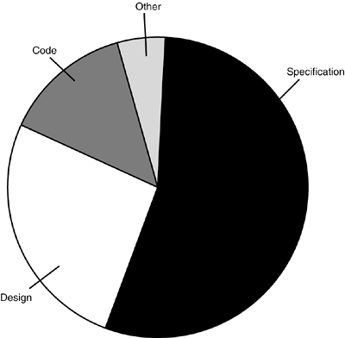
Figure: Why Do Bugs Occur
3. Why Do Bugs Occur?

Slide 8
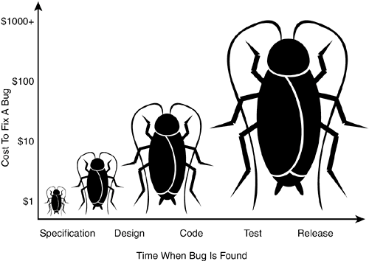
Figure: The Cost of Bugs
4. The Cost of Bugs

Slide 9
What Exactly Does a Software Tester Do?
5. What Exactly Does a Software Tester Do?
The goal of a software tester is to find bugs.
The goal of a software tester is to find bugs and find them as early as possible.
The goal of a software tester is to find bugs, find them as early as possible, and make sure they get fixed.

Slide 10
6. What Makes a Good Software Tester?
They are explorers.
They are troubleshooters.
They are relentless.
They are creative.
They are (mellowed) perfectionists.
They exercise good judgment.
They are tactful and diplomatic.
They are persuasive.

Slide 11
1. Infamous Software Error Case Studies
2. What Is a Bug?
3. Why Do Bugs Occur?
4. The Cost of Bugs
5. What Exactly Does a Software Tester Do?
6. What Makes a Good Software Tester?

Slide 12
Quiz:

Slide 13
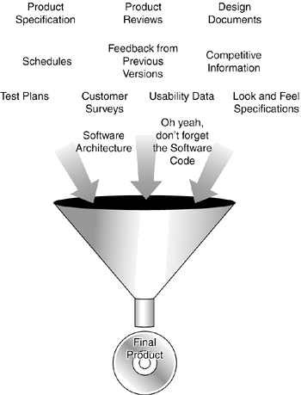
Figure: Product Components
1. Product Components

Slide 14
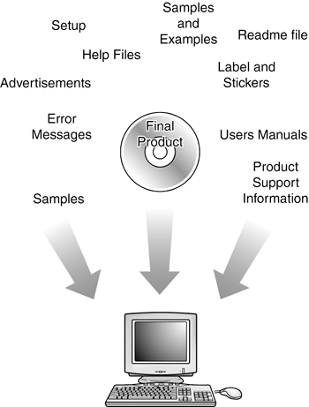
Figure: Product Components

Slide 15
Error: Keyboard not found. Press F1 to continue.
Can't instantiate the video thing.
Windows has found an unknown device and is installing a driver for it.
A Fatal Exception 006 has occurred at 0000:0000007.

Slide 16
2. Software Project Staff
Project managers, program managers, or producers
Architects or system engineers
Programmers, developers, or coders
Testers or QA (Quality Assurance) Staff
Technical writers, user assistance, user education, manual writers, or illustrators
Configuration management or builder

Slide 17
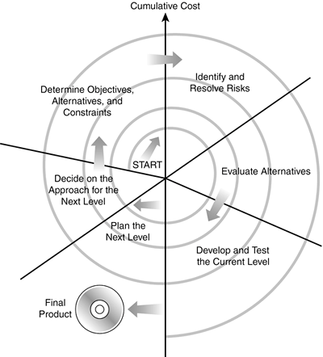
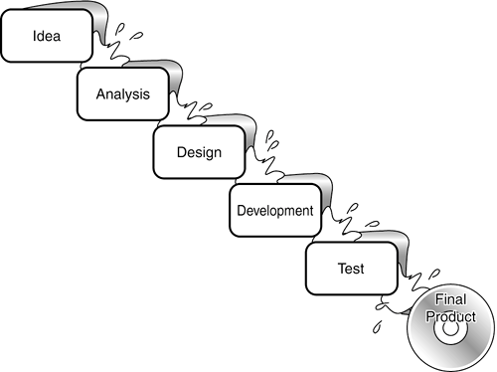
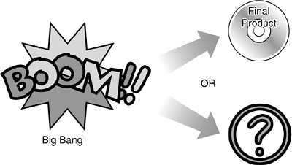
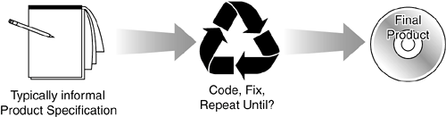
Figure: Software Development Lifecycle Models
3. Software Development Lifecycle Models
Big-Bang
Code-and-Fix
Waterfall
Spiral

Slide 18
1. Product Components
2. Software Project Staff
3. Software Development Lifecycle Models

Slide 19
Quiz:

